Slide 1
Making the Mid West a better place to live, work and invest
Trish Palmonari
PPM Business Development
28 November 2014

Slide 2
Mid West Development Commission
Promotes sustainable development of the Mid West
Promotes and assists eligible groups to access State and Federal Government funding programs
Developing networks between government, industry and community
“What is happening in the Mid West”
Promotion of the business capability in the region and helping Government and private industry to “Buy Local”
State Government liaison
Notes:
The Commission also actively promotes and assists eligible groups to access State and Federal Government funding programs including our own funding program the Royalties for Regions Mid West Regional Grants Scheme, Mid West Investment Plan and Community Chest Fund.
In addition, the Commission acts as a referral point, assisting people and groups working on projects, and business or industry to develop products/services that will have benefits for the whole Mid West community.
Some of this assistance includes:
Developing networks between government, industry and community by putting our clients in touch with the right people.
Providing information and advice including regional statistics and information about “What is happening in the Mid West”.
Promotion of the business capability in the region and helping Government and private industry to “Buy Local”.
State Government liaison.
As the key State Government representative in the Mid West, a key part of the Commission’s work is to provide timely and accurate advice to the State on major issues impacting on the region’s development.
For detailed information on how we can help you go to What we can do for you.

Slide 3
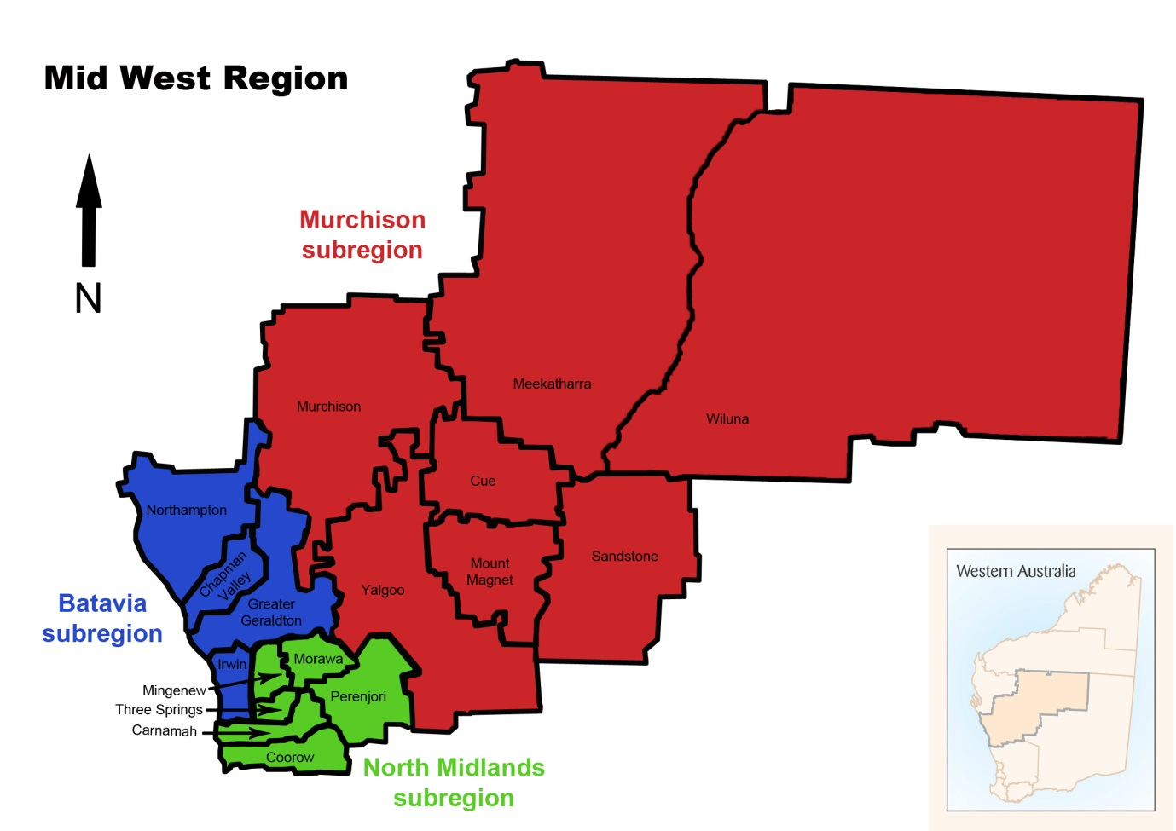
Mid West Sub Regions
89% landmass
8% population
6% landmass
84% population
5% landmass
8% population
Notes:
Michael suggested a very quick MW overview for context
Batavia Coast (CGG +3) – main population and service centre
Murchison (7 LGs) – mining, pastoral, Aboriginal
North Midlands (6 LGs) – traditional ag – moving more into mining

Slide 4
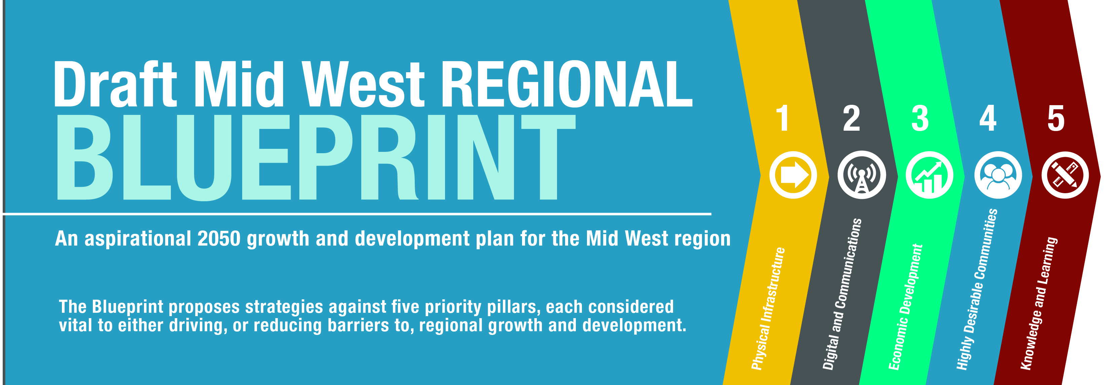
Partnership with RDA Midwest and Gascoyne
140+ consultations
Completed 8 weeks Public Comment (23 Sept – 18 Nov)
Launched - end 2014
Notes:
Driven by MWDC
- Opted not to simply engage external consultant – wanted MWDC to drive it / own it / embrace it
- Sue Middleton employed as lead project manager – embedded in agency with MWDC staff in partnership
Developed in partnership with RDA Midwest and Gascoyne
Will also become RDAs Blueprint for regional development
Made early decision to align with State Planning Strategy and other key regional development frameworks
Mid West Regional Planning and Infrastructure Framework
Regional centres development plan
Northern Australia policy etc.
Considered all relevant previous regional and State plans / strategies
140 consultations over 6-9 MThs (p13)
Largely ‘bottom up’ – strong community and local government engagement
- had a strong focus on community ownership and buy in
- recognises LG as asset manager and major focus
Heavy State government engagement - recognising – regional and head office based (DGs, Chairs etc.)
- recognises that agencies still have portfolio responsibility (manage, govern, regulate etc.)
- MWDC to focus and development on growth opportunities eg aquaculture
Draft circulated to tier 1 stakeholders
Enabled us to re-engage particularly with State agencies, local governments and key groups
Current draft incorporates their feedback – confident it accords with their view and plans for the future
Very well received by the region

Slide 5
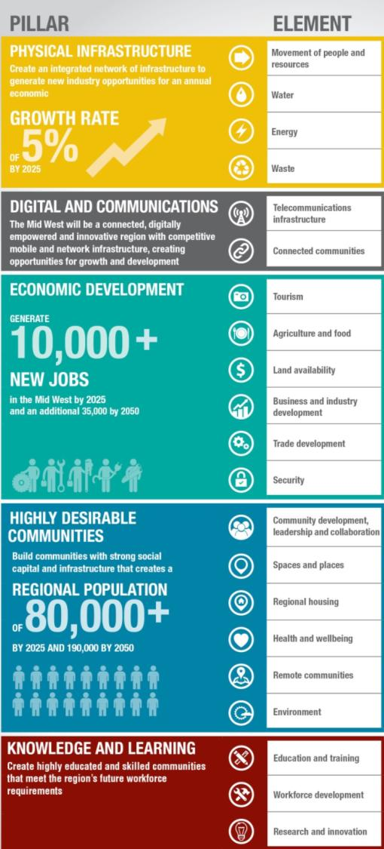
Notes:
Region overwhelmingly supported a growth and development agenda
Responsible – balance growth / development against social and environmental concerns
Vision
Outward focus – major gateway to the globe – requires investment in strategic infrastructure, market development, new product / industry development
Inward focus – Mid West populations capture maximum benefits from any periods of growth and prosperity
Identified five focus areas (pillars) and 21 elements - which include:
- Tailwinds – drive growth and development eg infrastructure / business and industry development
- Headwinds – need to be addressed to remove barriers / enable growth and development eg education

Slide 6
Notes:
GT?

Slide 8
SME Business Development Strategy
SED Advisory appointed
MW Chamber of Commerce & Industry led
Identify 6 - 8 significant projects
Mid West business growth
Encourage new business
Support new & new business creation.
Notes:
SED Advisory has been appointed to work with the Commission, Mid West Chamber of Commerce and Industry and the community in developing the strategy

Slide 9
We seek your participation
Contact Mr Tony Irish,
0413 260 183 or via email tonyi@sedadvisory.com
Alternatively
Trish Palmonari 0428 210 712 or trish.palmonari@mwdc.wa.gov.au

Slide 10
Questions

